Slide 1
Attention
Rachel Thomas, PhD
June 2019

Slide 2
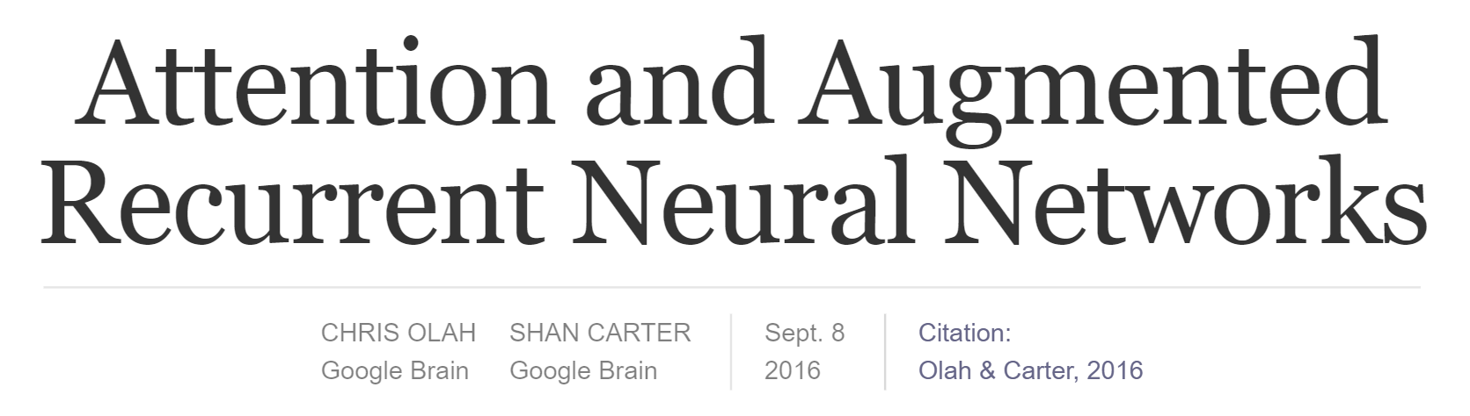
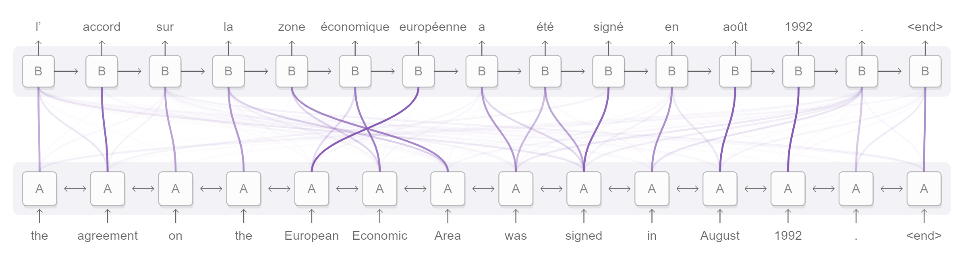
https://distill.pub/2016/augmented-rnns/

Slide 3
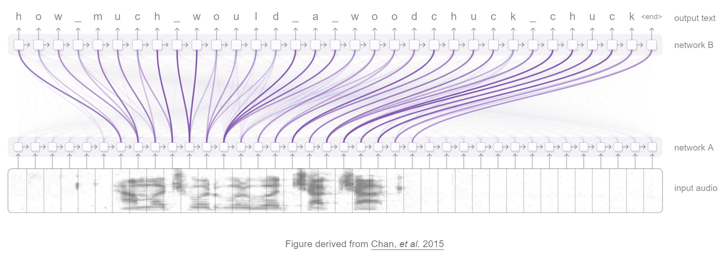
https://distill.pub/2016/augmented-rnns/

Slide 4
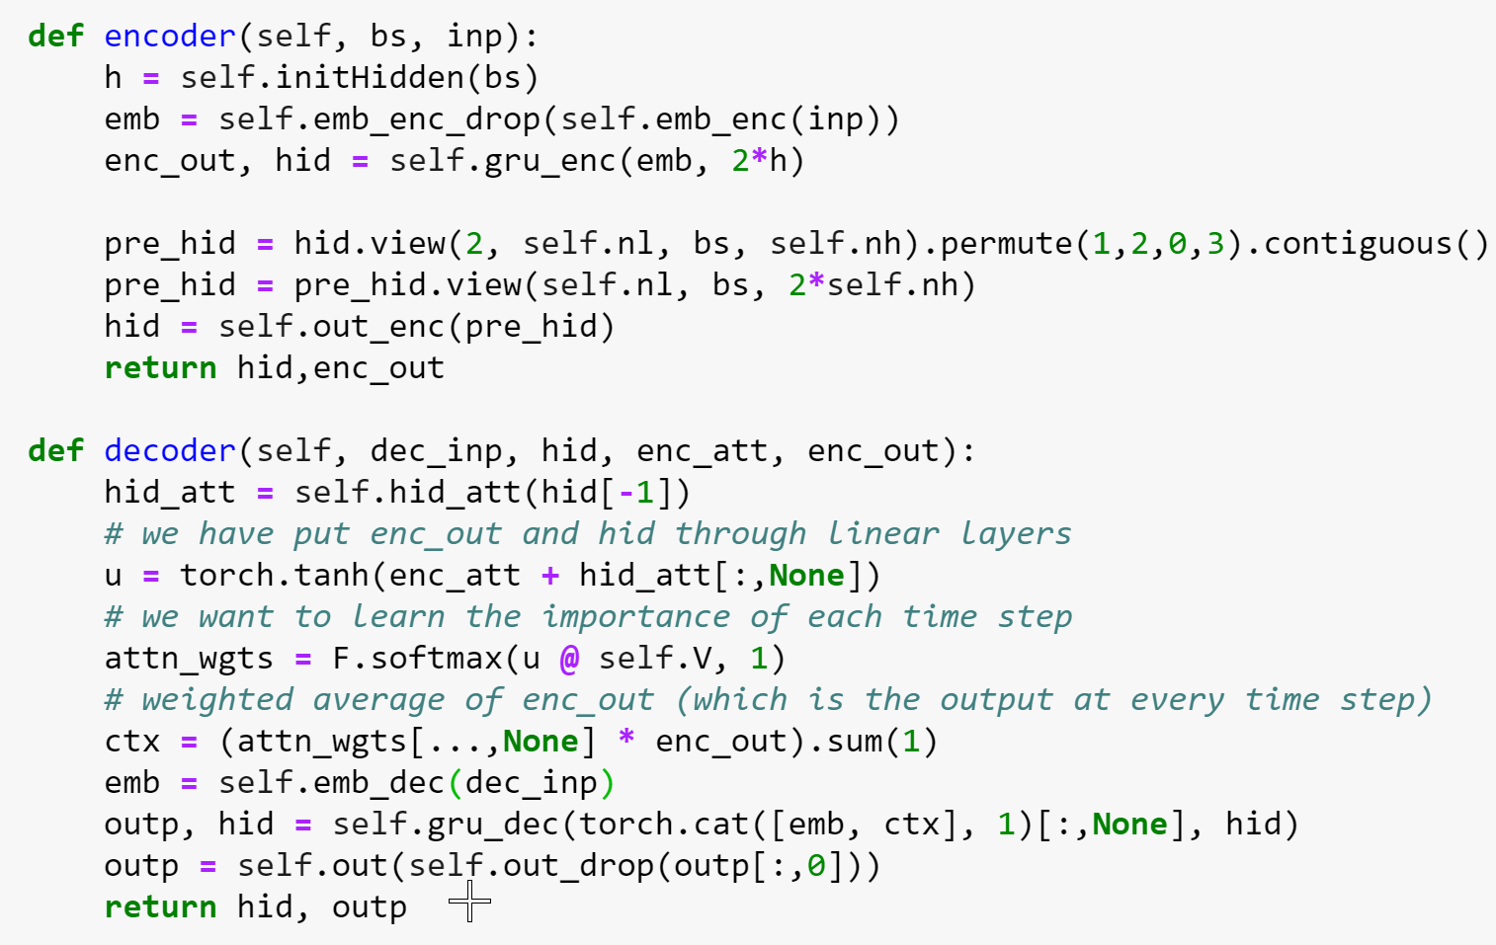
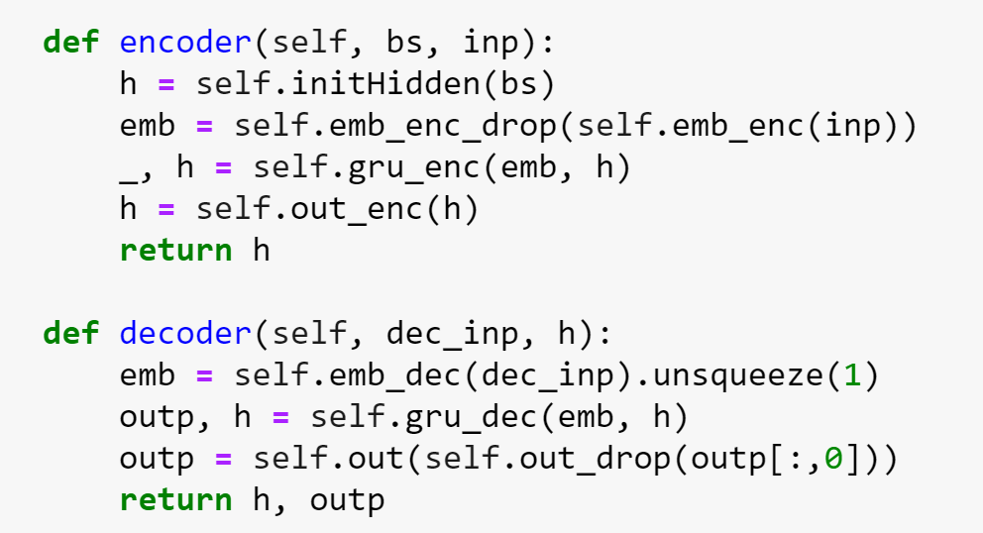

Slide 5
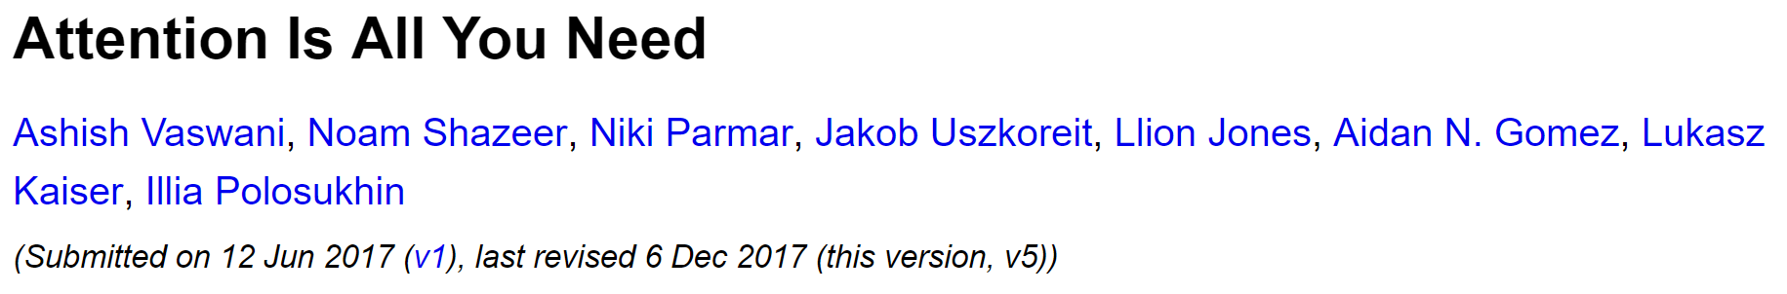
Get rid of RNNs and CNNs: “just use attention” (and positional encoding, fully-connected neural net, etc…)
English-to-German and English-to-French translation
More accurate
More parallelizable
Faster to train

Slide 6
Motivation
“This inherently sequential nature [of RNNs] precludes parallelization within training examples, which becomes critical at longer sequence lengths, as memory constraints limit batching across examples.”

Slide 7
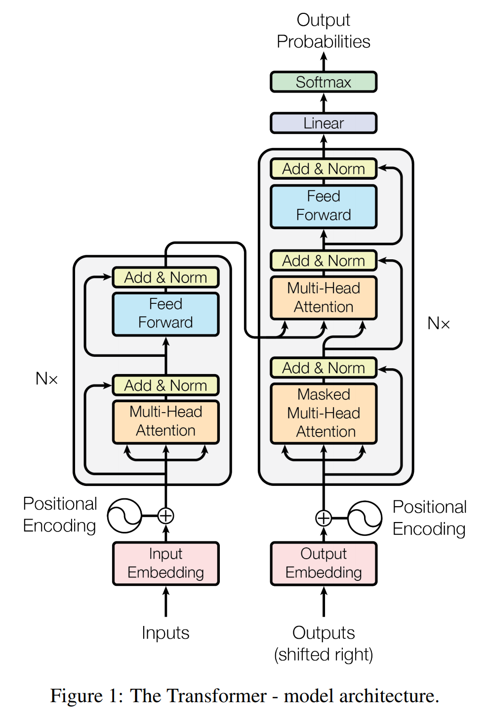

Slide 8
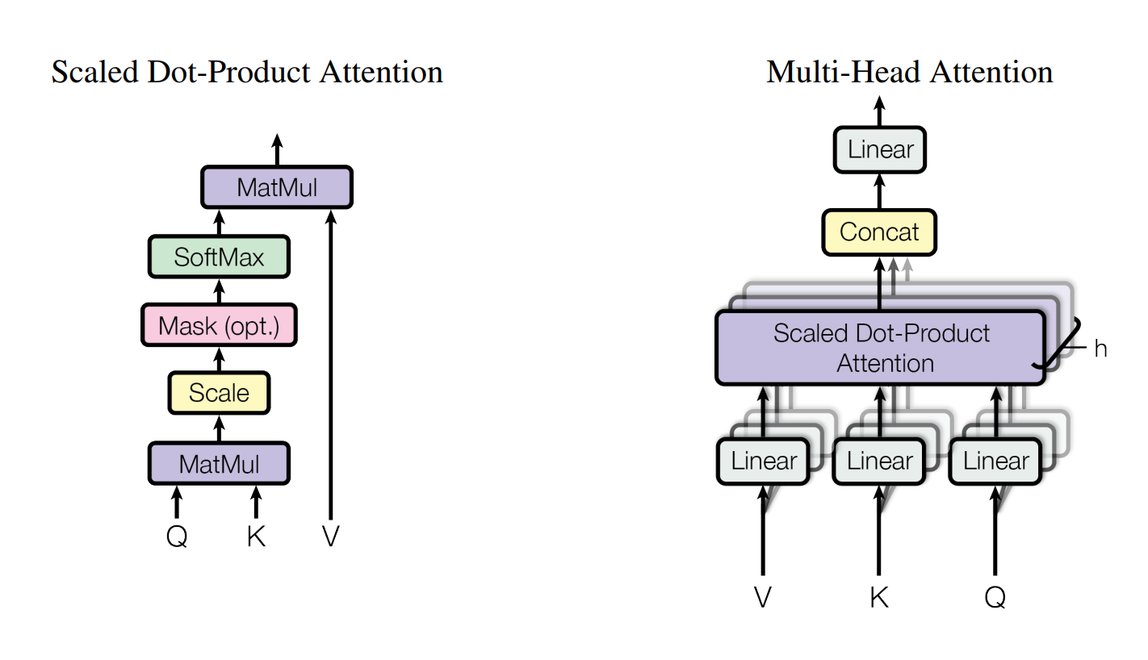
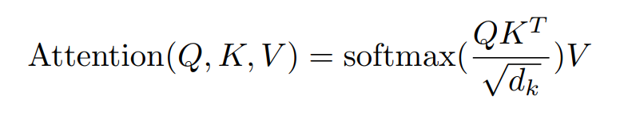

Slide 9
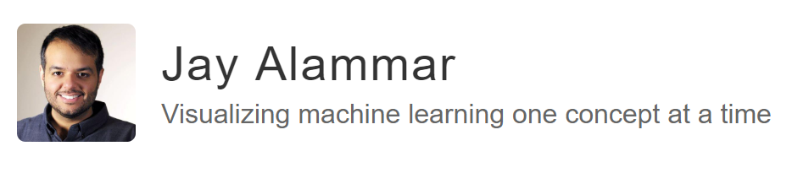
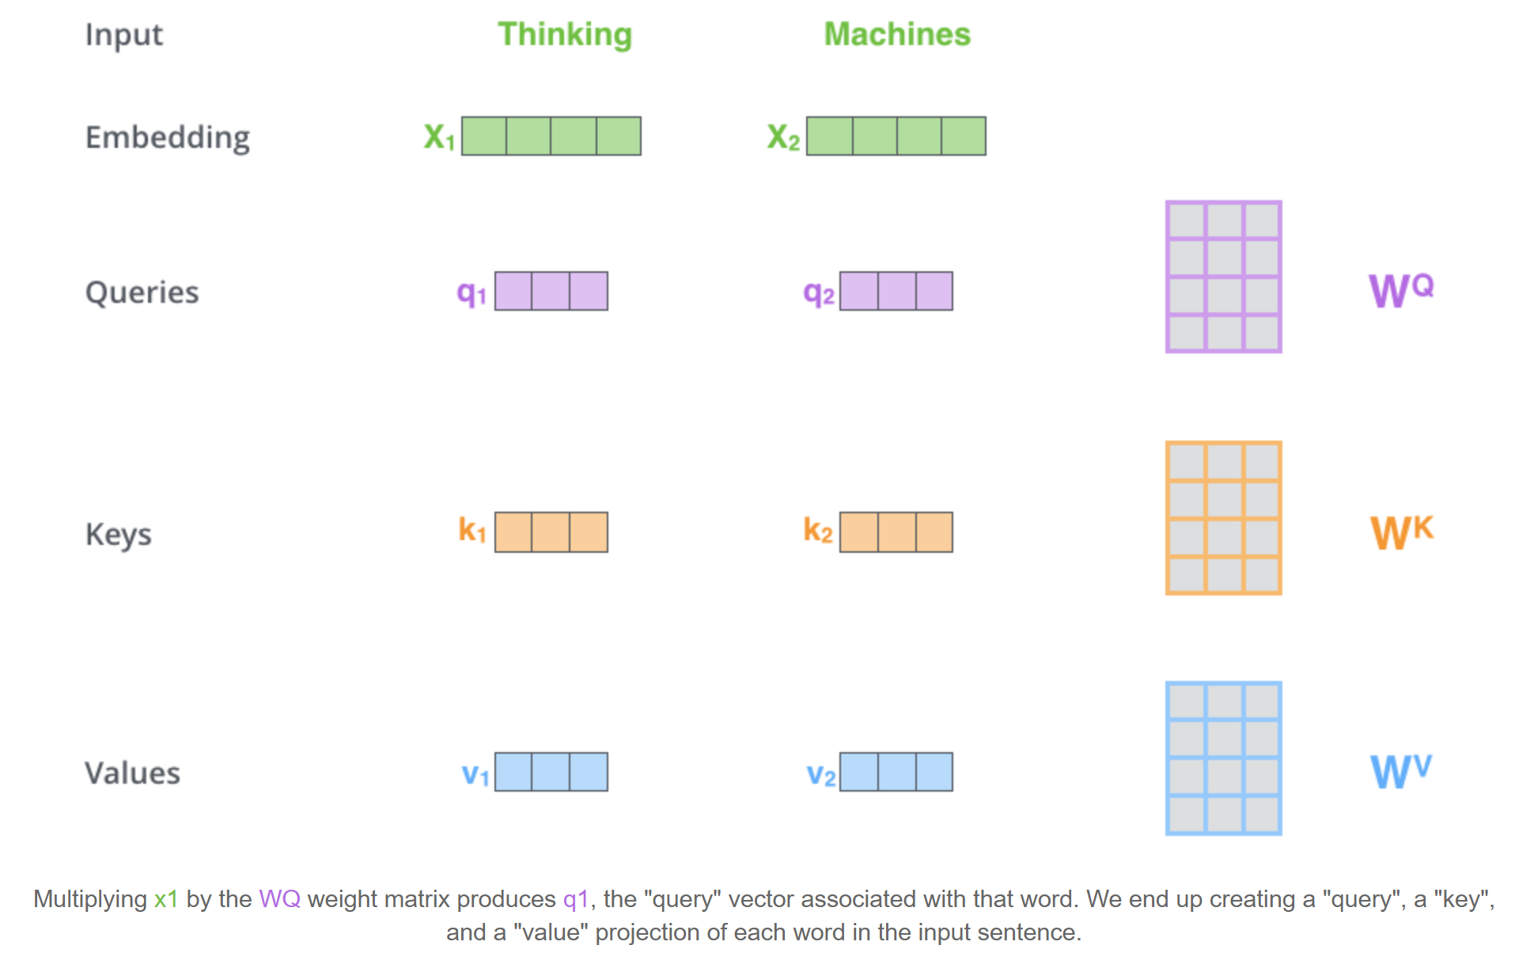

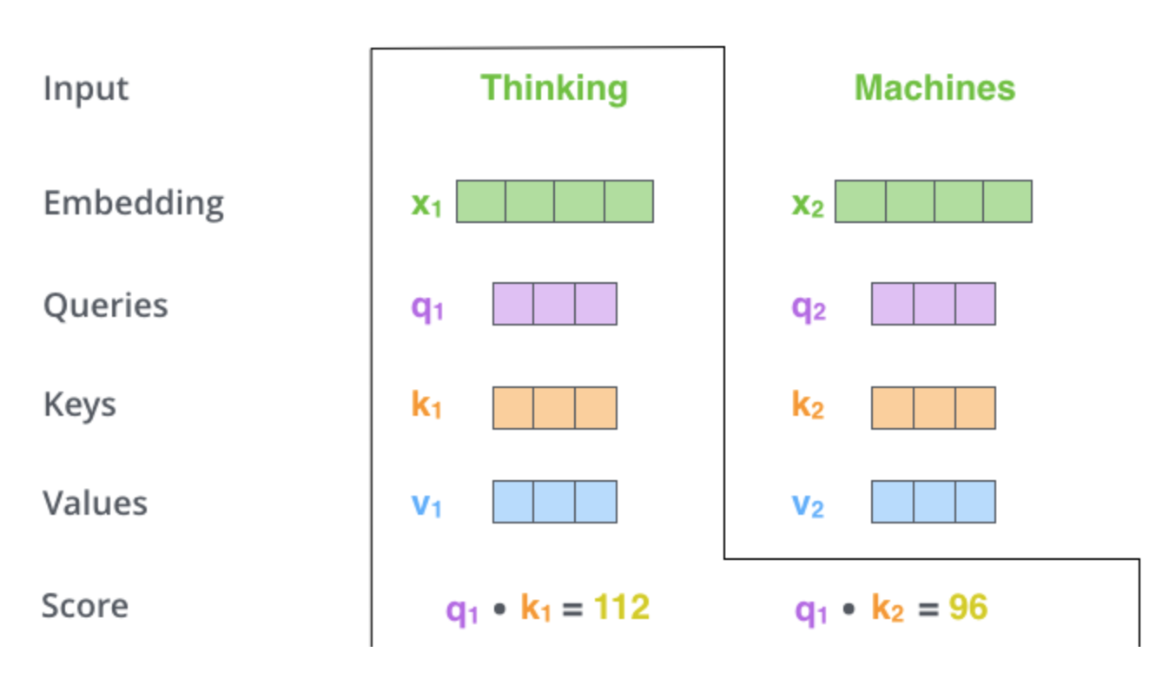

Slide 10
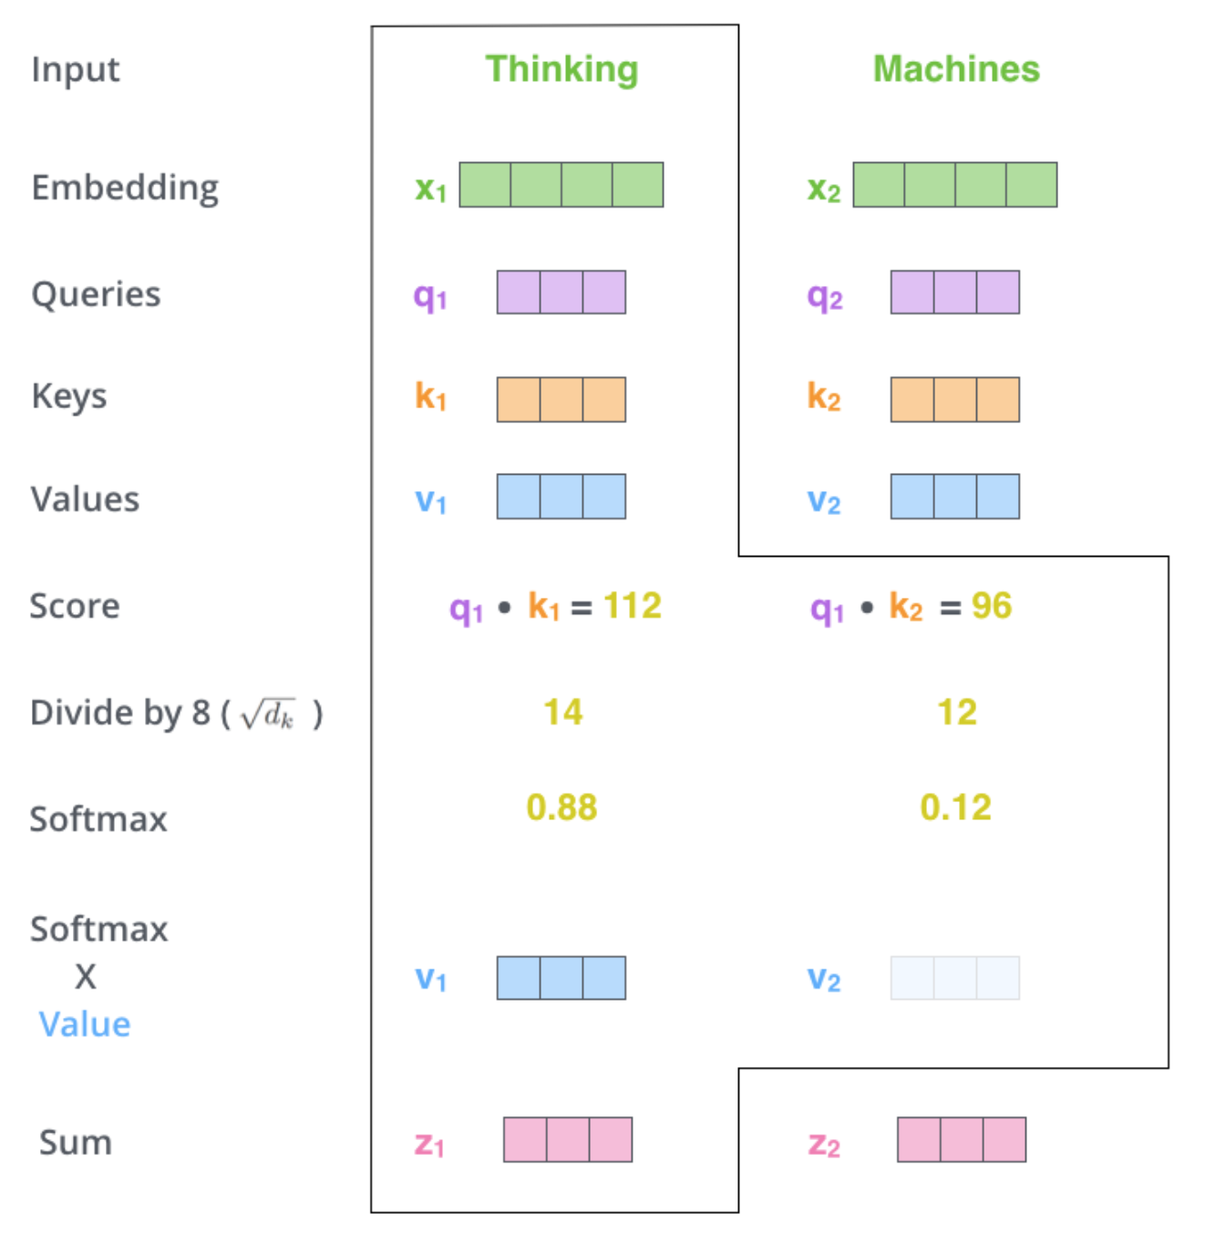

Slide 11
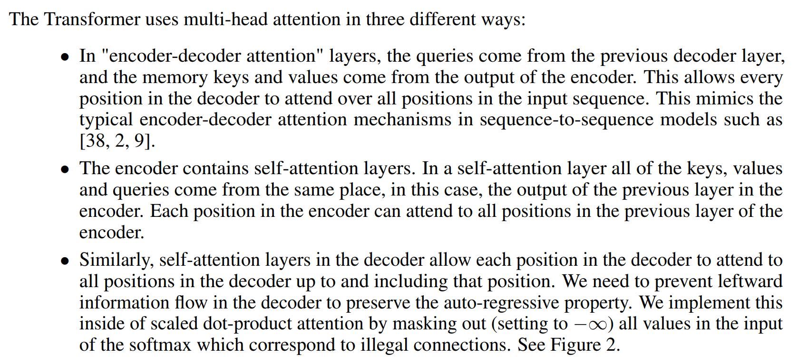

Slide 12
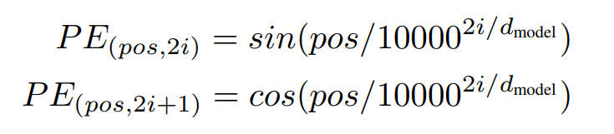
Positional Encoding
“Since our model contains no recurrence and no convolution, in order for the model to make use of the order of the sequence, we must inject some information about the relative or absolute position of the tokens in the sequence.”

Slide 13
